Slide 1
Deep Learning Course
Logistic Regression

Slide 2
Review from Last Week
Slides are not lecture notes
Linear Regression --- linear functions
Linear Regression -- Cost Functions
Linear Regression -- Optimization
Linear Regression -- Variants

Slide 3
Logistic Regression Problem Statement
Same as for Linear Regression with the only difference being that our Target variable is Binary rather than real valued

Slide 4
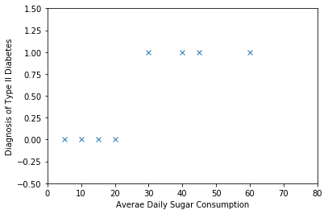
Example Problem

Slide 5
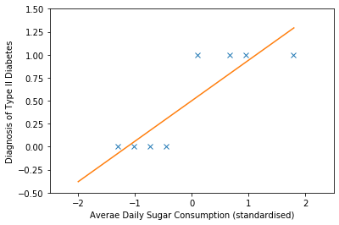
Modelling Binary Problem with Linear Regression

Slide 6
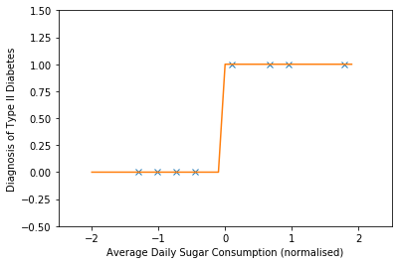
Using a Step Function

Slide 7
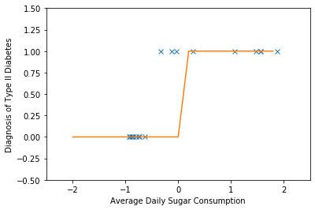
Problems with Linear Regression Approach

Slide 8
Aside: Alternative Visualisations

Slide 9
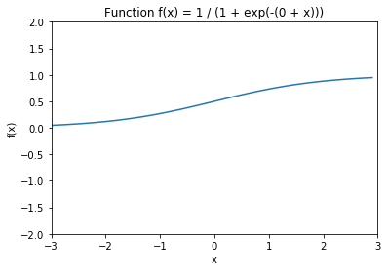

Logistic Function

Slide 10
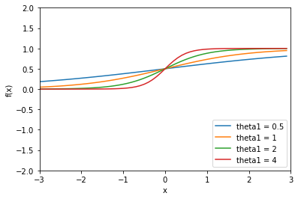
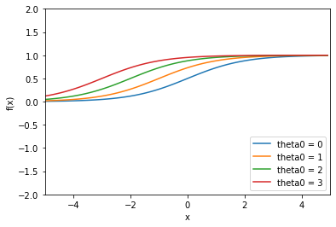
Varying the parameters

Slide 11
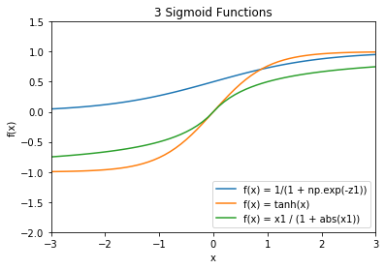
Logistic Fn as an Example of Sigmoid Functions

Slide 12
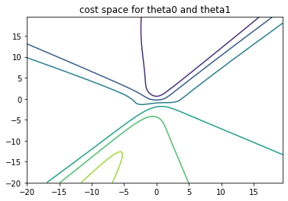
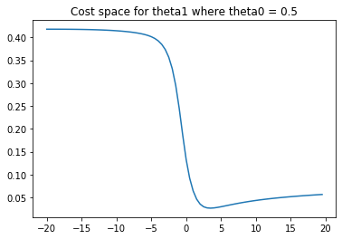
Cost Function - Applying Linear Cost Function

Slide 13
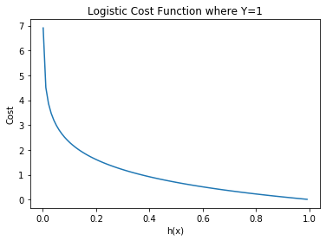
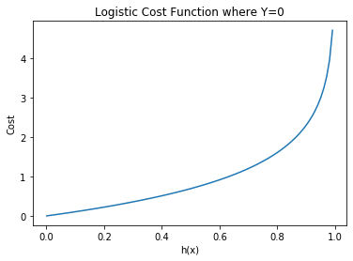
Cross Entropy Loss Function

Slide 14
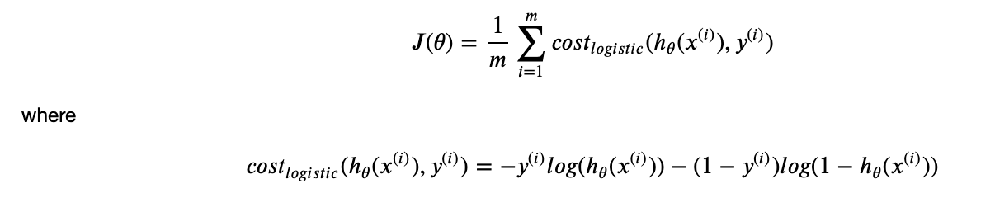
Logistic Cost Function

Slide 15
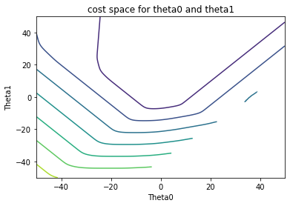
Plotting the Costs

Slide 16

Gradient Descent for Logistic Regression

Slide 17
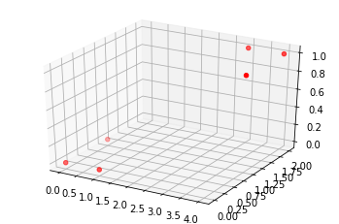
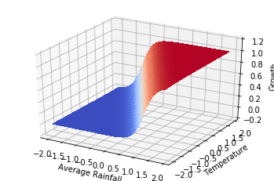
Multivariate Logistic Regression

Slide 18
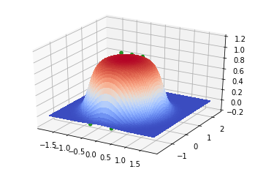
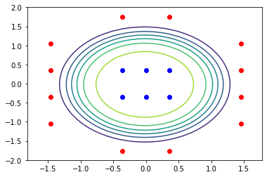
Non Linear Logistic Regression

Slide 19
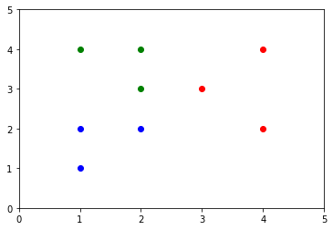
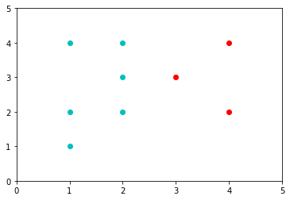
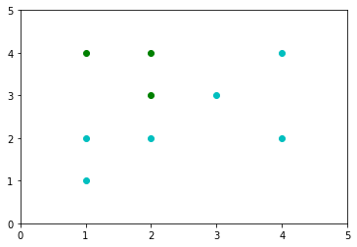
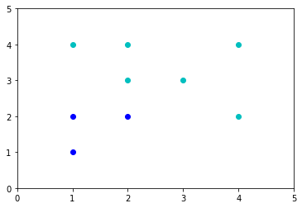
Multinomial Logistic Regression

Slide 20
Lab Work
Take the example of tweet sentiment classification, and write an outline of how the challenge of tweet classification would match up to the mechanisms of logistic regression.
Would there be a problem applying linear regression to tweet classification? If so, what?
Come up with a novel logistic regression example that takes at least 3 features and compare execution with both a Bayeesian (or Decision Tree) approach and Logistic approach.

